Slide 1
Vasileios Siampos
Multi-Layered Security Monitoring for Kubernetes and Containers
Supervisor
Prof. Georgios Kambourakis
Committee
Prof. S. Kokolakis; Assoc. Prof. G. Spathoulas
Dept.
Information & Communication Systems Engineering
University
University of the Aegean
with Open Source Tools
A four-layer defence-in-depth architecture, validated
against a deliberately vulnerable Kubernetes cluster.
ΒSc Thesis
September 2026
https://github.com/SoloBary/Multi-Layered-Security-Monitoring-for-Kubernetes-and-Containers-with-Open-Source-Tools

Slide 2
What I will cover
The problem
The argument
1
2
Why Kubernetes defaults create risk
Where each tool goes blind
The architecture
The attacks
3
4
Four layers, all open source
Five scenarios mapped to MITRE ATT&CK
The measurements
Limits & conclusions
5
6
Coverage, accuracy, operational cost
What this does not claim

Slide 3
The problem is not exotic exploitation
Misconfiguration accounts for the majority of real-world Kubernetes compromise
What a default Kubernetes deployment provides to a workload — before you configure anything:
DEFAULT
DEFAULT
DEFAULT
DEFAULT
Runs as root
Token mounted
Flat network
No limits
UID 0 in the container is UID 0 on the host
API credentials at a predictable path
Every pod reaches every other pod
One workload can starve its neighbours
None of these are bugs.
They are documented defaults chosen to make the platform easy to adopt. Each one is also a step an attacker does not have to take on their own.
Tesla 2018 (dashboard without password) · Shopify 2018 (SSRF)

Slide 4
No single tool is sufficient
Each class of tool is effective within its scope — and blind outside it
Image scanner
BLIND TO
Sees every CVE in the image
Blind to everything after the container starts
Admission controller
BLIND TO
Rejects workloads that violate policy
Cannot tell a compromised pod from a healthy one
Service mesh
BLIND TO
Enforces mTLS, exposes traffic flows
A token read off local disk never touches the network
Runtime detection
BLIND TO
Sees every syscall the workload makes
Detects after the fact — it does not block
The blind spots are structural — they follow from where each tool sits in the lifecycle, not from poor engineering.

Slide 5
Research questions
RQ1
Can a complete defence-in-depth stack be built entirely from open source components?
RQ2
Which MITRE ATT&CK techniques does each layer catch, and where do coverage gaps remain?
RQ3
What is the operational overhead — particularly the runtime layer that processes every syscall?
RQ4
Is the coverage complementary, or are the layers just alerting on the same things?
RQ5
What tuning is required to make a default ruleset usable without creating blind spots?

Slide 6
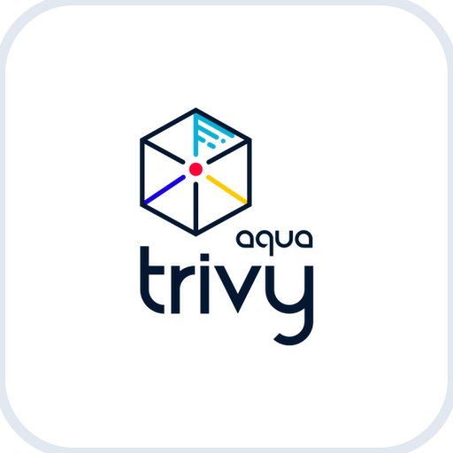






The architecture
Four layers positioned across the workload lifecycle
PRE-RUNTIME
ADMISSION
NETWORK
RUNTIME
1
2
3
4
Trivy Operator
Kyverno
Istio + Kiali
Falco
Continuous CVE
scanning
5 ClusterPolicies
enforced at admission
mTLS STRICT
service graph
eBPF syscall
detection
Observability spine
TARGET
Prometheus
Grafana
Loki
kube-goat
metrics
dashboards
logs
Deliberately vulnerable,
documented misconfigurations
Counters tell you something happened. Log search tells you what.

Slide 7
Monitoring, prevention, enforcement
Three different things the phrase 'security control' hides
MONITORING
PREVENTION
ENFORCEMENT
Observes and records. Blocks nothing.
Refuses the operation before it takes effect.
Constrains what is possible during execution.
Trivy · Falco · Loki
Kyverno
Istio mTLS STRICT
IF IT FAILS
IF IT FAILS
IF IT FAILS
Failure: attack proceeds unobserved
Failure: workload runs that should have been refused
Failure: execution of an operation that should be impossible
Adversary model: code execution already achieved inside a pod. From that foothold — escalate, harvest credentials, move laterally, persist.

Slide 8
The environment
Everything reproducible from the repository
$ kind create cluster --config kind-config.yaml
name: thesis-lab
node: kindest/node:v1.32.0
kind: v0.26.0
extraMounts: /proc /sys /
# required for eBPF probe to reach
# host kernel data structures
Deployed stack
Falco
0.43.0
Falcosidekick
2.32.0
Kyverno
v1.17.1
Trivy Operator
0.30.1
Istio + Kiali
1.24.0
kube-prometheus
v0.89.0
Loki Stack
v2.9.3
kube-goat — target
Why a vulnerable-by-design target
Runs as root
The admission layer needs genuine violations to reject. If I construct them myself, I am grading my own homework. kube-goat ships workloads that are misconfigured in specific, documented ways.
SA token mounted and exposed
Images tagged :latest
No CPU or memory limits
github.com/SoloBary/thesis-poc · manifests · custom rules · evidence artefacts

Slide 9
1
Pre-runtime — Trivy Operator
Continuous scanning as a controller, not a one-shot pipeline step
How it works
Why the Operator, not a CLI scan
Runs as a Kubernetes controller. Scans every image in the cluster against CVE databases and publishes findings as VulnerabilityReport custom resources — queryable with kubectl like any other object.
A pipeline scanner evaluates an image once, against the database as it stood that day. A workload deployed in March and still running in July has not been re-evaluated. The Operator re-scans on its own cycle — no human action required.
$ kubectl get vulnerabilityreports -A -o custom-columns=\
NAMESPACE:.metadata.namespace,CRITICAL:.report.summary.criticalCount,HIGH:.report.summary.highCount
NAMESPACE NAME CRITICAL HIGH
default replicaset-metadata-db-... 89 930
default replicaset-build-code-... 20 101
default job-batch-check-job-batch-check 15 92

Slide 10
What the scanner found
Before a single attack command was executed
133
CRITICAL CVEs
across kube-goat workloads
1,245
HIGH CVEs
one image alone accounts for 930

Slide 11
2
Admission control — Kyverno
The last point at which a workload can be prevented from existing
block-privileged
privileged: true is refused
Kyverno over OPA/Gatekeeper
These are structural assertions about pod specs. Expressing them in YAML that mirrors the object being validated is direct. Rego delivers the same enforcement with a second policy language to learn and maintain.
require-non-root
runAsNonRoot must be set
block-latest-tag
:latest is non-deterministic
block-host-namespaces
hostNetwork, hostPID, hostIPC
Namespace exceptions
require-resource-limits
CPU and memory limits mandatory
System namespaces are excluded — falco, kube-system, monitoring, istio-system, trivy-system, kyverno. Without them, Kyverno blocks its own DaemonSets. The kube-goat namespaces are never excluded.

Slide 12
Enforcement against the real target
Redeploying a kube-goat workload with all policies in Enforce mode
$ kubectl apply -f /tmp/hunger-check.yaml -n big-monolith
Error from server: admission webhook "validate.kyverno.svc-fail"
denied the request:
resource Deployment/big-monolith/hunger-check-deployment was blocked
due to the following policies
require-non-root:
validation error: Containers must not run as root.
failed at path /spec/template/spec/containers/0/securityContext/
require-resource-limits:
validation error: Resource limits are required.
failed at path /spec/template/spec/containers/0/resources/limits/
34%
40%
0%
violation rate
violation rate
violation rate
default namespace (kube-goat)
secure-middleware (kube-goat)
falco namespace — policies correctly excluded

Slide 13
3
Network — Istio and Kiali
Identity derived from workload, not from network location
STRICT over PERMISSIVE
What this buys you
PERMISSIVE accepts plaintext for gradual migration — it enforces nothing. STRICT rejects plaintext at the proxy. Every connection requires a valid certificate; identity comes from the service account, not from network location.
An attacker with execution in one pod cannot passively read traffic between two others, and cannot impersonate a service without also holding that service's certificate. Kiali renders the service graph, making cross-namespace traffic visible as an edge.
PeerAuthentication — all kube-goat namespaces
default
STRICT
big-monolith
STRICT
secure-middleware
STRICT
100% mTLS
100% mTLS
100% mTLS

Slide 14
4
Runtime — Falco on eBPF
Every privileged operation a workload performs crosses the syscall boundary
Kernel
Falco
Falcosidekick
eBPF probe at syscall entry/exit
Rules evaluated against event stream
Alerts to UI, Prometheus, Loki
Why modern_ebpf
Tuning: append, never disable
Kernel 6.8 has no prebuilt Falco driver
The default ruleset fires on kubelet mounts, Prometheus scrapes, node-exporter reads — all legitimate. Disabling those rules creates permanent blind spots. Instead, macros are extended with override: condition: append to whitelist specific system images and namespaces.
kind nodes carry no kernel headers
CO-RE resolves struct layouts against BTF at load time
One object runs on any BTF kernel ≥ 5.8
No init container, no compilation, no per-kernel artefact
The kube-goat namespaces are never whitelisted.

Slide 15
Five attack scenarios
Executed against kubernetes-goat-home in the default namespace, mapped to MITRE ATT&CK
1
Sensitive file access
Read sensitive file untrusted
T1555
cat /etc/shadow
2
Fileless execution
Execution from /dev/shm
T1620
/dev/shm/evil
3
Service account token
Read K8s Service Account Token *
T1528
cat .../serviceaccount/token
4
Command and control
Detect curl or wget in container *
T1105
curl -s http://example.com
5
K8s API lateral movement
Contact K8S API Server
T1613
curl -k https://kubernetes.default.svc
* Custom rules — the default Falco ruleset has no detection for either. The absence of SA token detection is a finding in itself.

Slide 16
Why scenario 2 matters
The technique that connects this lab to a real campaign
Fileless execution — T1620
CanisterWorm — March 2026
/dev/shm is a memory-backed filesystem. A binary written there and executed leaves no artefact on disk — nothing to scan, no hash to match, no on-disk indicator. File integrity monitoring is defeated completely.
A threat actor published malicious versions of Trivy and its GitHub Actions. A credential stealer paired with a self-propagating worm harvested npm tokens and republished infected packages autonomously. Spread across 141 packages.
execve is still visible. The kernel must still be invoked to run a process
Persistence mechanism: execution from /dev/shm.
Trace it through the stack
Trivy
flags the compromised package before deployment — if the malicious version is known
Falco
sees the /dev/shm execution regardless of how the binary arrived
Kiali
surfaces the outbound connection to C2 that has no reason to exist

Slide 17
MITRE ATT&CK coverage
Only techniques demonstrated with captured evidence are claimed
TECHNIQUE
DESCRIPTION
DETECTED BY
LAYER
T1195.002
Supply chain compromise
Trivy
Pre-runtime
T1078
Valid accounts — token exposure
Kyverno
Admission
T1555
Credentials from files
Falco
Runtime
T1620
Reflective code loading
Falco
Runtime
T1528
Steal application access token
Falco
Runtime
T1105
Ingress tool transfer
Falco
Runtime
T1613
Container and resource discovery
Falco + Kiali
Runtime + Network
—
Lateral movement — cross-namespace
Istio / Kiali
Network
Scope is strictly limited to techniques empirically validated in the lab environment..

Slide 18
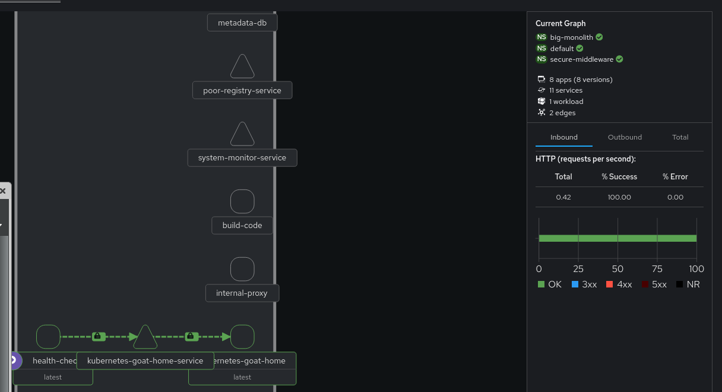
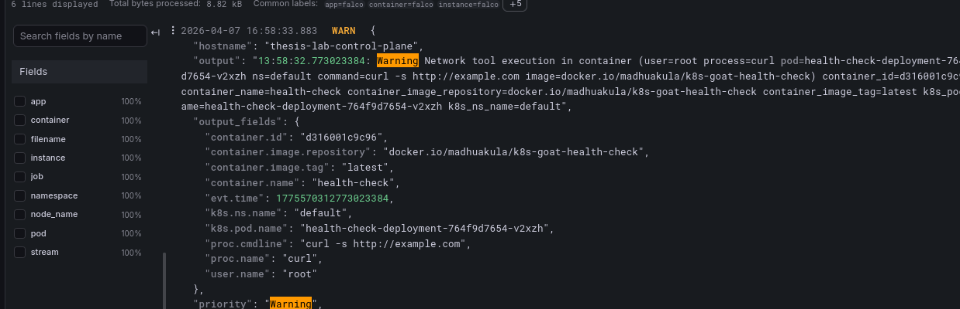
The same cluster, seen from two layers
Captured live — both screenshots are in the repository
Istio / Kiali — mTLS on every edge
Loki — the event behind the counter
{namespace="falco", container="falco"} |= "Warning"
Prometheus triggered an alert. Loki logs show curl example.com executed by health-check (root) in the default namespace, including the full command line.
Three namespaces in the mesh, all green. Each padlock badge is mutual TLS.
This is why both are deployed.

Slide 19
What it costs to run
Falco processes every syscall on the node — measured live from Prometheus
CPU
MB RAM
syscalls/sec
event drops
5.5%
158
8,823
0
of one core, sustained
resident set size
sustained throughput
nothing missed
Zero drops is the number that matters
Collected from Prometheus
A dropped event is not a performance statistic — it is an attack that was never evaluated, and it leaves no trace. At 8,823 syscalls per second with zero buffer loss, nothing escaped the detection pipeline during the observation window.
falcosecurity_falco_cpu_usage_ratio * 100
falcosecurity_falco_memory_rss_bytes
rate(falcosecurity_scap_n_evts_total[1m])
sum(falcosecurity_scap_n_drops_buffer_total)

Slide 20
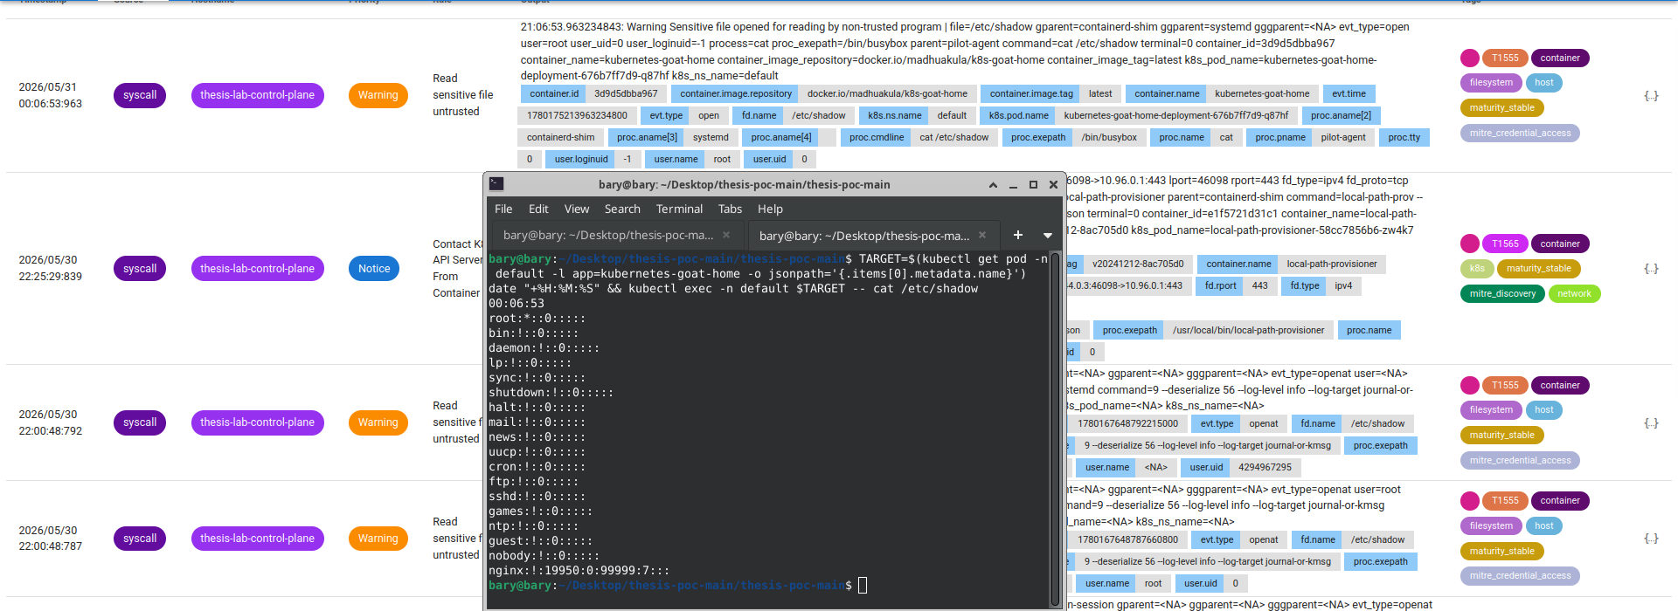
Detection latency
From syscall to alert visible in the console
00:06:53
00:06:53.963
< 1 s
command issued
alert timestamp
one measurement, not a distribution
date "+%H:%M:%S" && kubectl exec … cat /etc/shadow
Read sensitive file untrusted · T1555 · Warning

Slide 21
What tuning actually achieved
Noise removed, coverage kept — not a count of alerts
BEFORE
AFTER
kubelet, Prometheus, node-exporter
all firing alerts constantly
Silent on legitimate activity —
attacks still fully detected
0
alerts from legitimate platform activity
after tuning — verified from Prometheus
No FP rate is presented — a meaningful before/after comparison needs a stable baseline of known benign activity, which this environment is too basic to provide. A percentage here would be a number without a method behind it.

Slide 22
Decisions I had to defend
Every choice in the repository has a recorded rationale
modern_ebpf
Kyverno
over legacy eBPF
over OPA/Gatekeeper
CO-RE and BTF — no kernel headers, no compilation at startup, no per-kernel artefact to distribute
Native YAML policies — no second policy language for structural assertions about pod specs
Macro append
mTLS STRICT
over disabling noisy rules
over PERMISSIVE
A disabled rule is a permanent blind spot everywhere; an extended whitelist is narrowly scoped
PERMISSIVE accepts plaintext for gradual migration — for a security demonstration it enforces nothing

Slide 23
What this work does not claim
Stated up front rather than discovered in questions
Single-node cluster
Multi-node scheduling attacks and node-to-node lateral movement are out of scope. All four layers behave identically regardless of node count, but distributed failure modes are untested.
Runtime detects, it does not block
Prevention happens at admission and at the network proxy only. Anything reaching runtime undetected is recorded, not stopped. Tetragon would have offered kernel-level enforcement.
No image provenance
No signature verification, no trusted digest baseline. A malicious image carrying no known CVEs passes the scanning layer without objection — the exact gap the CanisterWorm attack would exploit.
Attacks run without evasion
Commands were executed directly, in a manner a knowledgeable adversary would avoid. The detection results are an upper bound, not a claim about performance against an active evader.
Control plane hardening, etcd encryption and RBAC design are separate subjects and are not addressed here.

Slide 24
Conclusions
RQ1
Yes — a functioning four-layer stack assembled entirely from open source, no commercial component anywhere.
RQ2
Eight ATT&CK techniques covered with captured evidence, across all four layers. Gaps: provenance and correlation.
RQ3
5.5% CPU, 158 MB, zero event loss at 8,823 syscalls per second. Runtime cost is not the obstacle assumed.
RQ4
Complementary, not redundant. Scenario 2 would have been missed by three of the four layers. One caught it.
RQ5
Macro extension removed system noise entirely while preserving full coverage on the attack surface.
No single tool is sufficient — and the combination is buildable, affordable, and reproducible today.

Slide 25
Where this goes next
Image signing and provenance
Enforcement at runtime
Cosign and Kyverno verifyImages — closes the supply chain gap
Tetragon alongside Falco — kernel-level termination, not just alerting
Correlation
Multi-node evaluation
Alerts into a SIEM so slow-and-low activity becomes an incident
Scheduling attacks, node-to-node movement, behaviour under partition
Evasion-aware testing
Network policy
Re-run scenarios with obfuscation to establish a realistic lower bound
Default-deny between namespaces, closing the flat network model

Slide 26
Repository
Thank you
https://github.com/SoloBary/Multi-Layered-Security-Monitoring-for-Kubernetes-and-Containers-with-Open-Source-Tools
Manifests · custom rules · PoC evidence · metrics
Questions welcome
Vasileios Siampos
Dept. of Information & Communication Systems Engineering
University of the Aegean · September 2026

